Slide 1

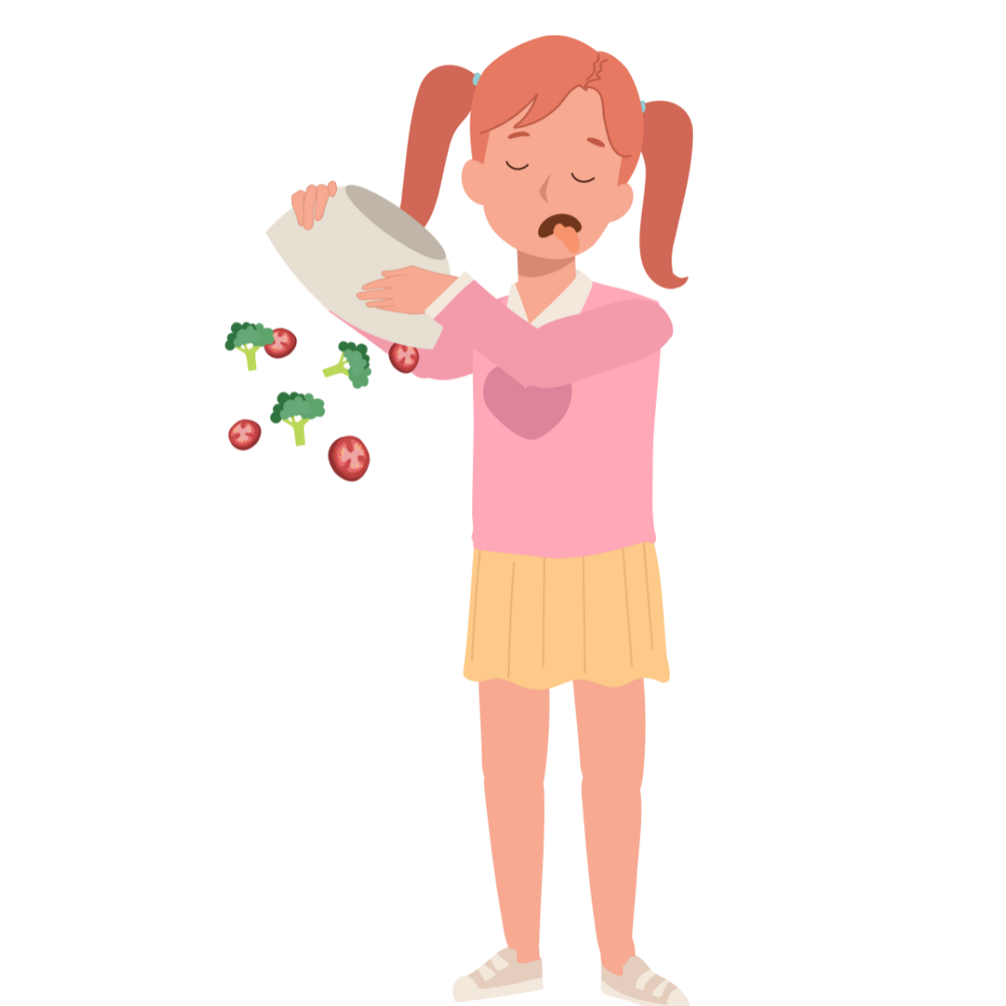


Slide 2

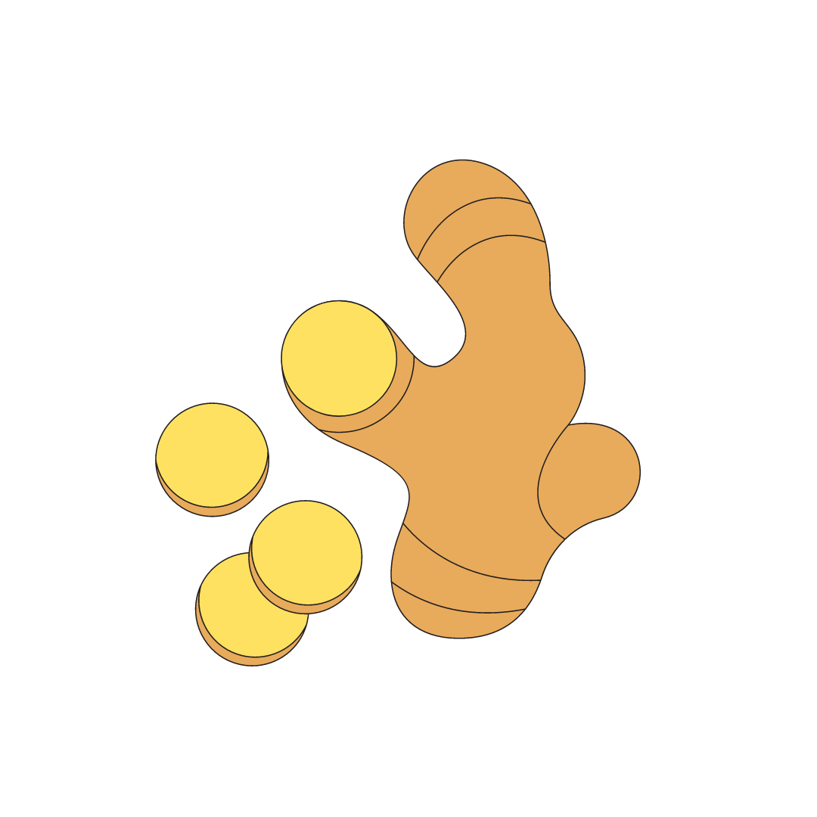

Slide 3
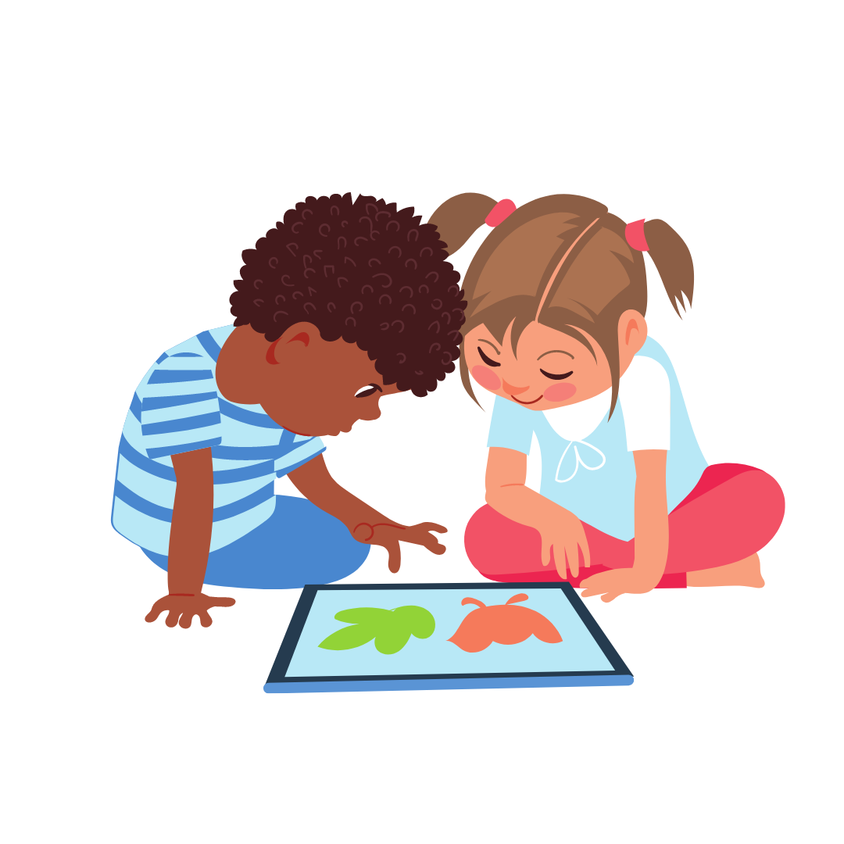
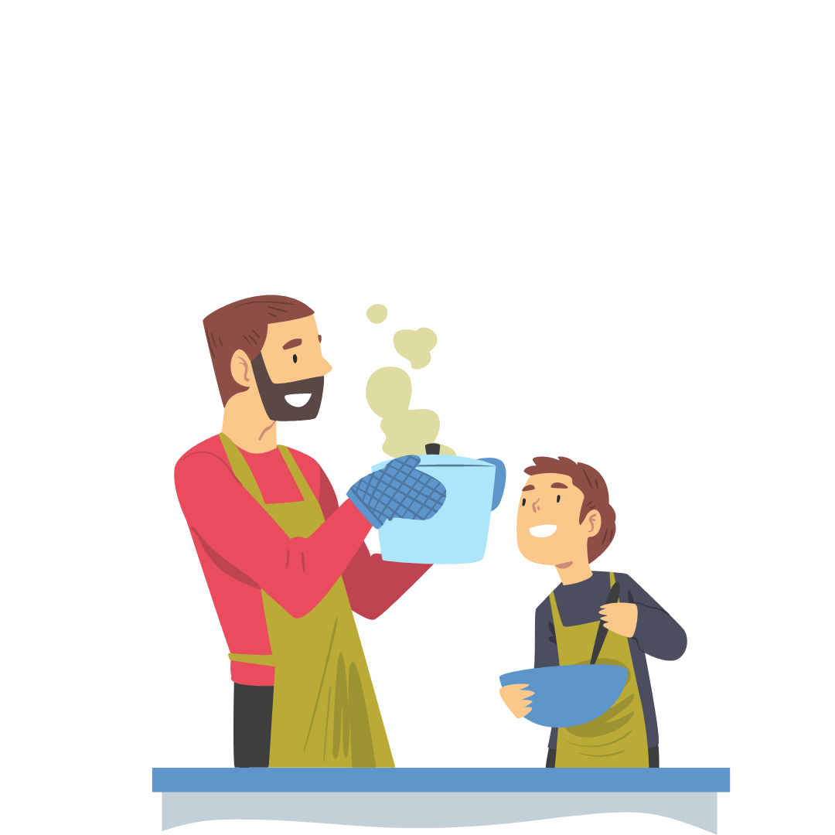

Slide 4
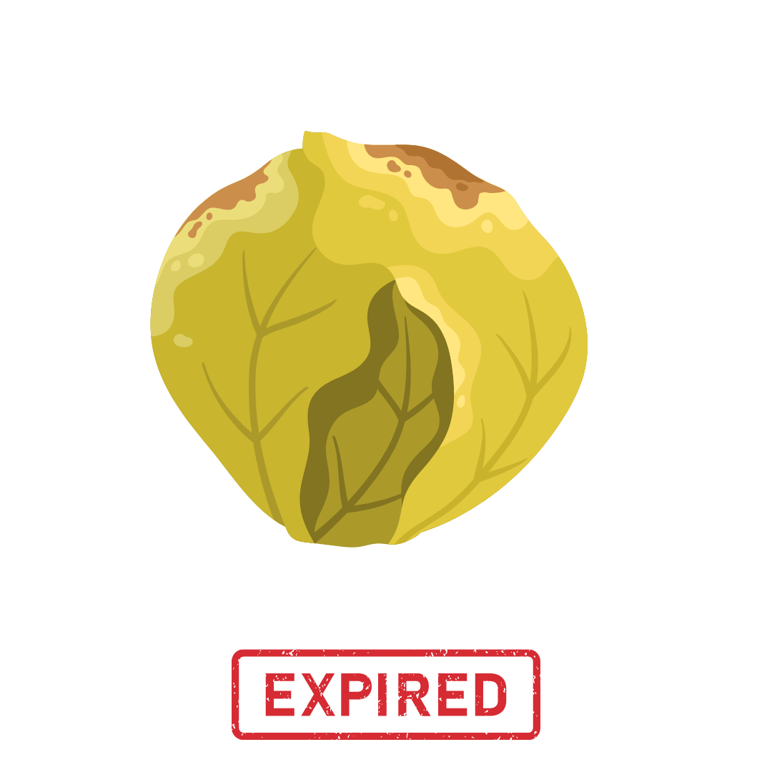

Slide 5

VEGGIE
TALES

Slide 6



VEGGIE
TALES

Slide 7




VEGGIE
Upload your image
Learning
To know and taste
TALES

Slide 8
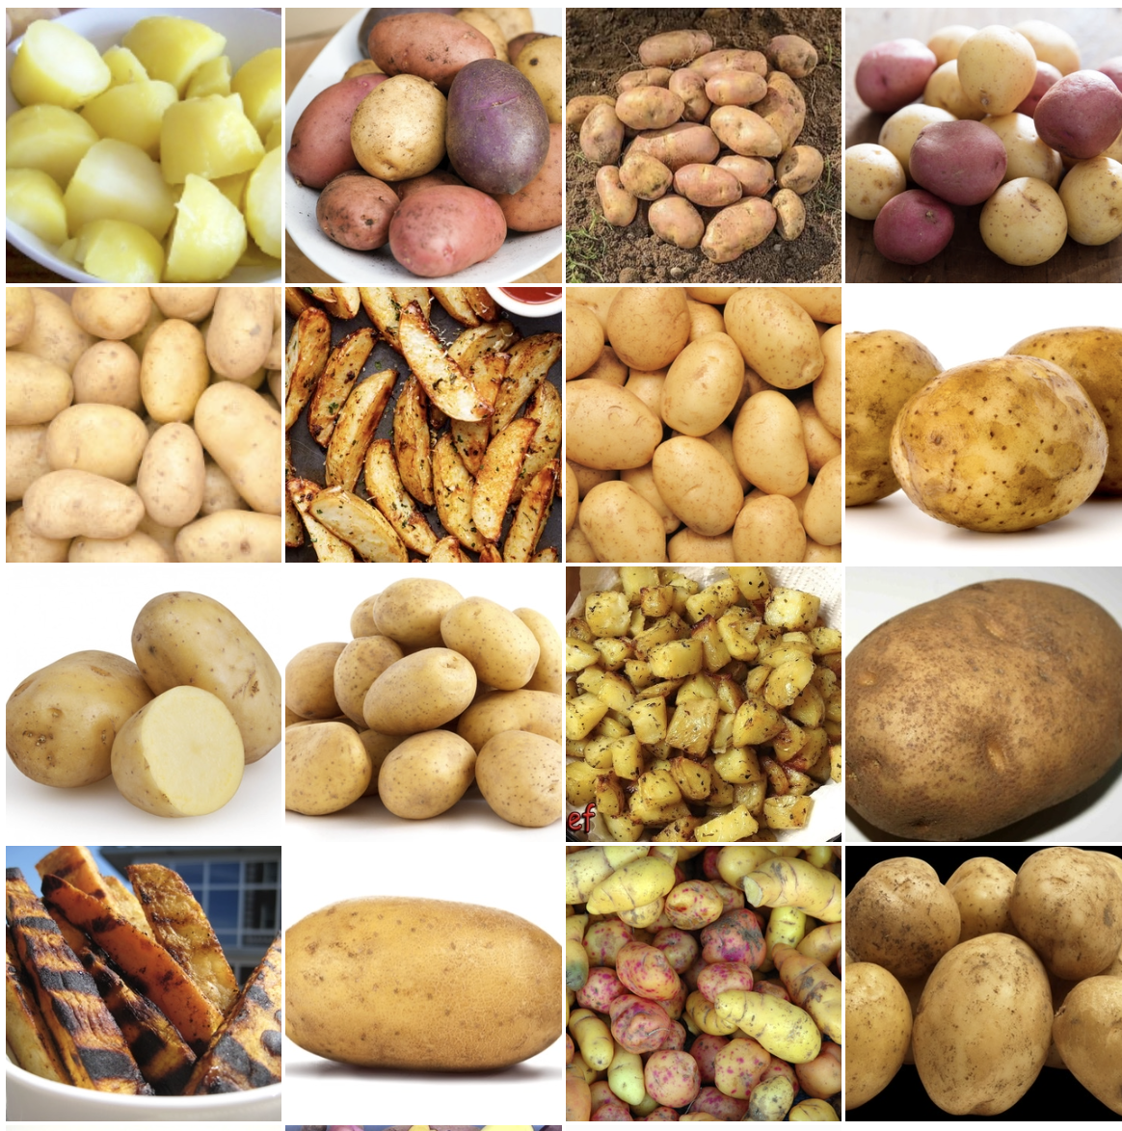
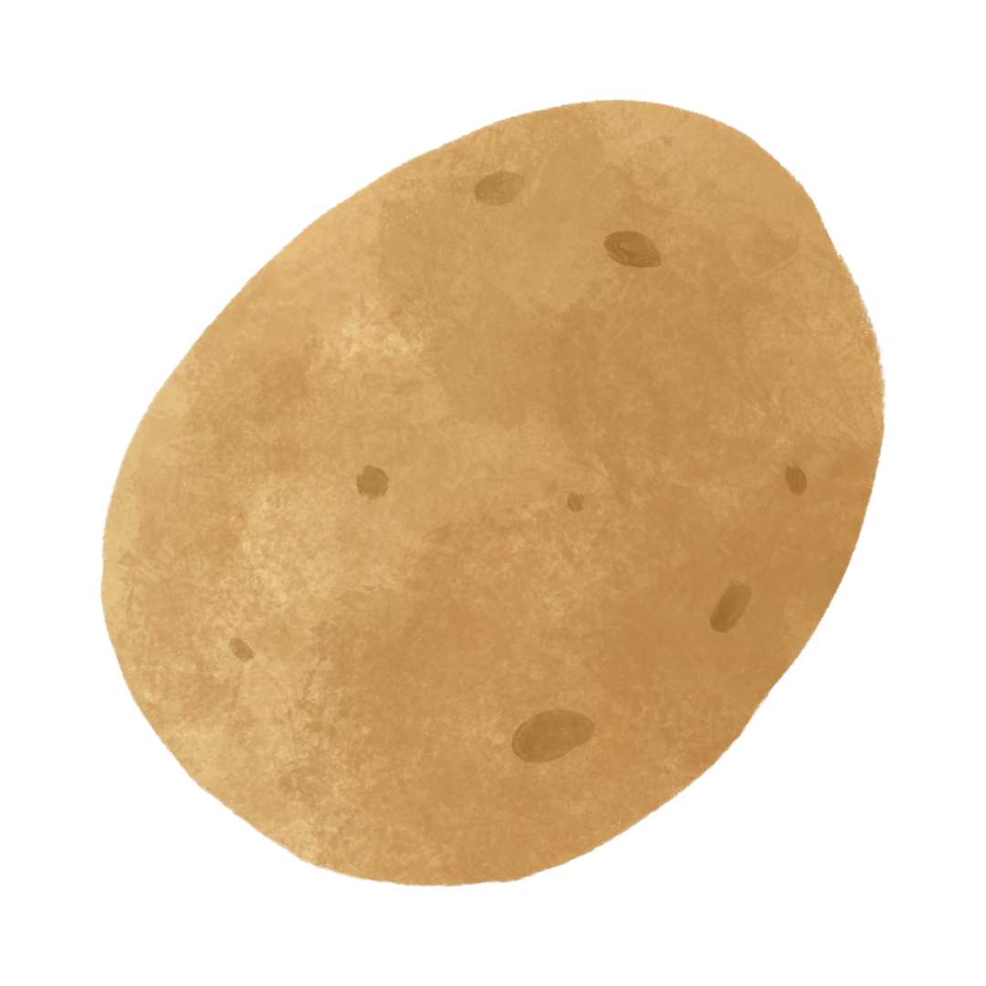
Learning
To know and taste
Upload your image

Slide 9
Learning
To know and taste
Upload your image
The image is a potato 🥔

Slide 10
Upload your image
To know and taste
Learning

Slide 11
Upload your image
To know and taste
Learning
Potatoes are the most consumed vegetables in the world! They're even more popular than tomatoes!

Slide 12
Upload your image
To know and taste
Learning

Slide 13

Upload your image
To know and taste
Learning
Once upon a time, there was a sprightly young potato called Pete…

Slide 14
Learning
Upload your image
To know and taste
Historical
Cultural
Health
Fun
Bad
Notes:
HERE ARE MY NOTES

Slide 15

Learning
Upload your image
To know and taste
Historical
Cultural
The Potato was among the first vegetables to be grown in space.
Health
Fun
Bad
Notes:
HERE ARE MY NOTES

Slide 16


Learning
Upload your image
To know and taste
Potato Frittata
Heat oil in a pan over medium heat. Add diced potato and cook until tender…
DISCLAIMER
Notes:
HERE ARE MY NOTES

Slide 17
HOW DID THE MODEL KNOW IT WAS A POTATO AND NOT AN ONION?
Learning
To know and taste
Upload your image
The image is a potato 🥔

Slide 18

VEGGIE
Starting model
Dataset: 2 classes, ~1k images per class
Validation accuracy: ~ 75%
Pretrained model
Dataset: 16 classes, 100 images per class
Validation accuracy: ~ 91%
Frozen
Unfrozen (15)

Slide 19
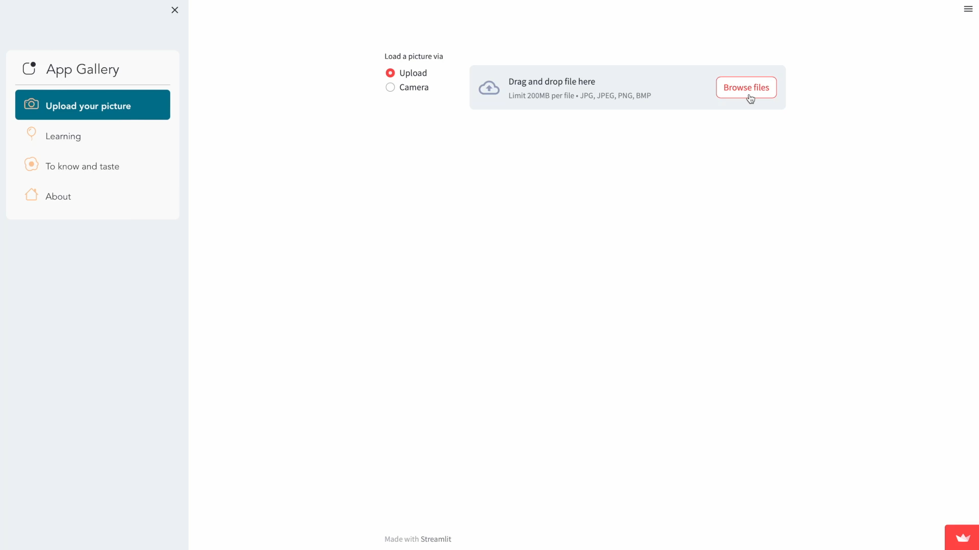
Streamlit App
THANK YOU FOR YOUR ATTENTION!

Slide 20
REFERNCIES
inceptionV3
https://www.kaggle.com/datasets/kritikseth/fruit-and-vegetable-image-recognition
https://www.kaggle.com/datasets/misrakahmed/vegetable-image-dataset

